Slide 1

WORLD DATA VISUALIZATION
Anna Garcia
Adolfo Linarez
Nelson Linarez

Slide 2
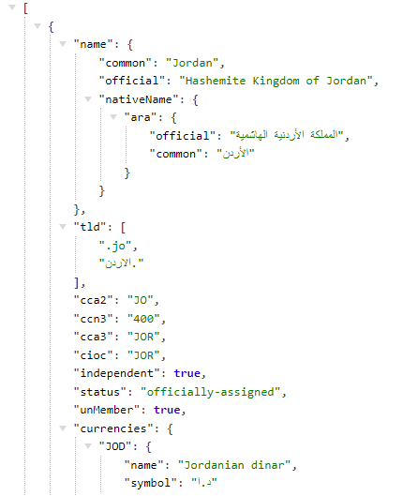
DATA SOURCE
https://restcountries.com/v3.1/all
VS Code - IDE (Integrated Development Environment)
Wide variety of public data describing 250 countries: Location, Border, Area, Population, Density, Language, Time Zone.

Slide 3

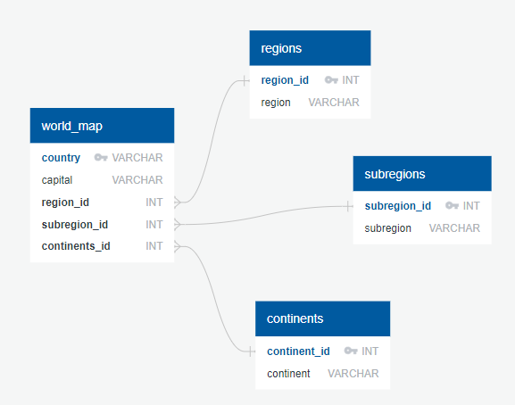
PROJECT INFORMATION
SQL Database houses the data for planning/visualization
Data cleaning with python and SQL
Displays Leaflet charts/maps built from data gathered through web scraping
Four unique views with user-driven interaction
Simple Statistics library

Slide 4
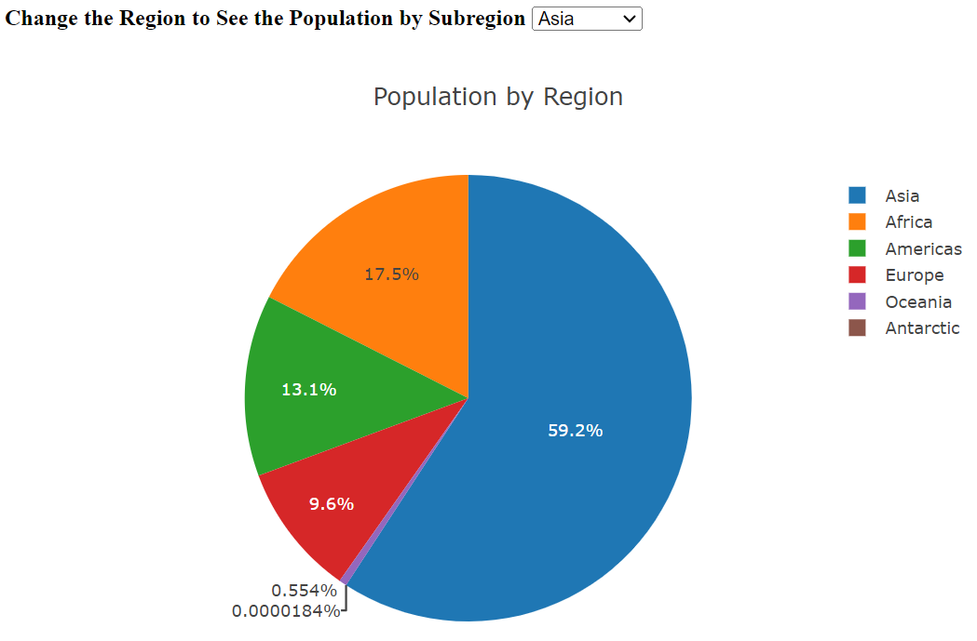
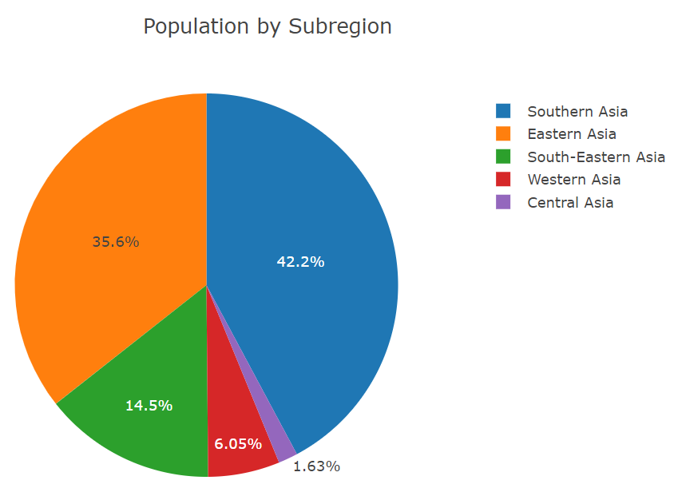
POPULATION PIE CHARTS
Shows percentage of population by region and subregion
Dropdown menu allows user to switch between each region’s subregions
Asia has the biggest share of the world’s population
Southern Asia is the largest subregion within Asia
Antarctic has the smallest share of the world’s population

Slide 5
Top 5 Most Common Languages by Region
Most Common Language in Oceania: English
Most Common Language in Americas: English
Most Common Language in Africa: English
Most Common Language in Europe: French
Most Common Language in Asia: Arabic
Most Common Language in Antarctic: English

Slide 6
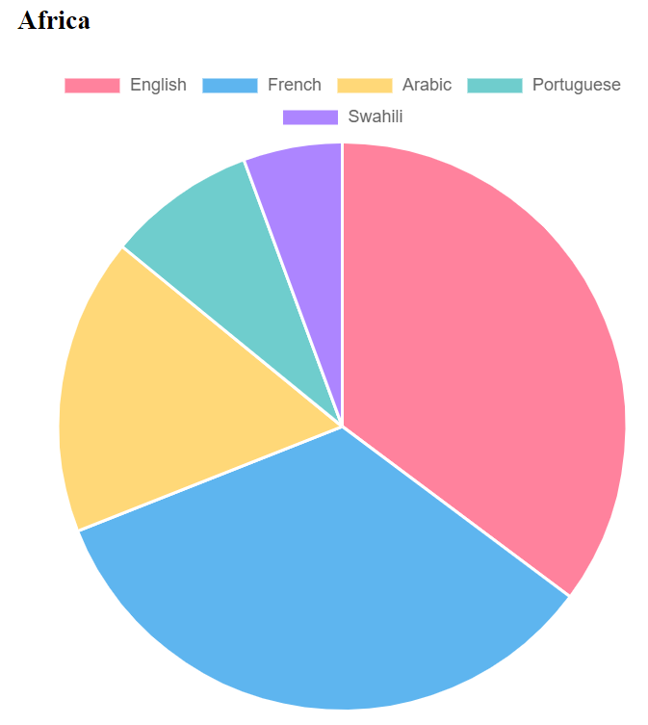
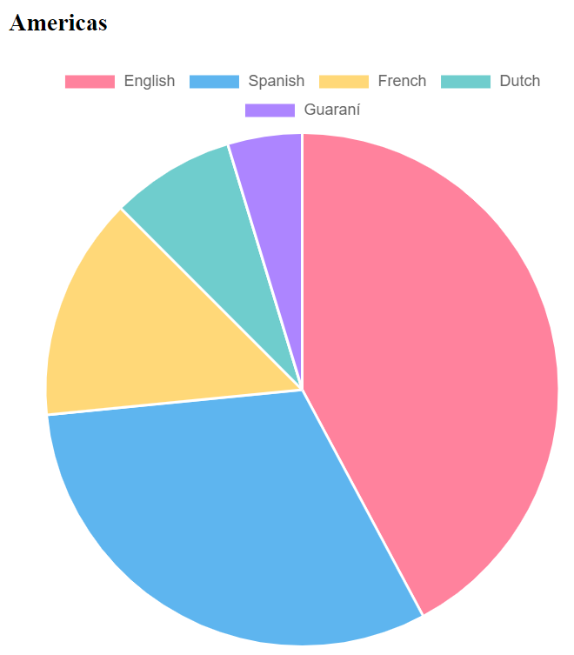
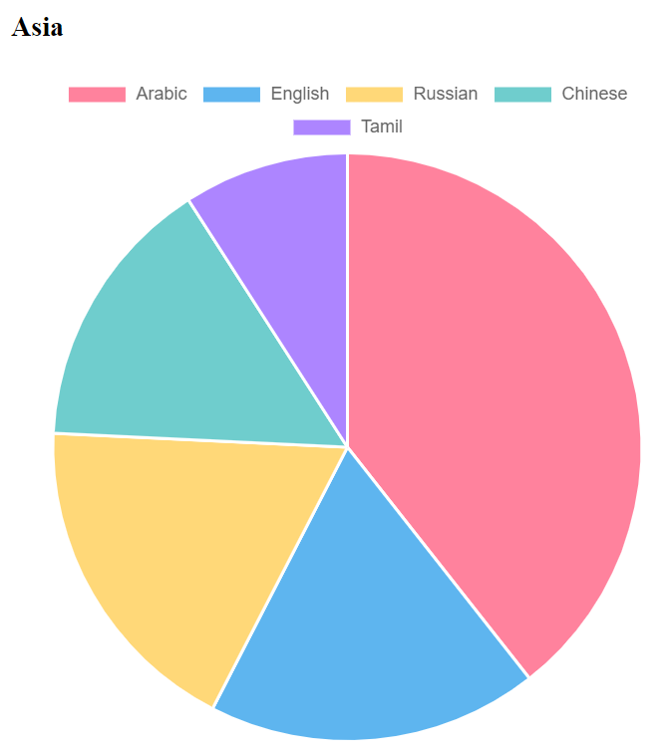
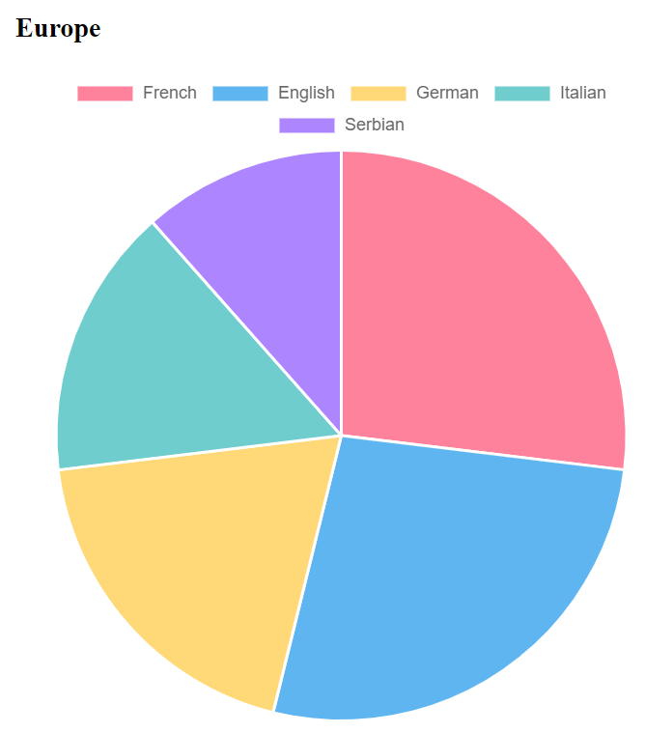
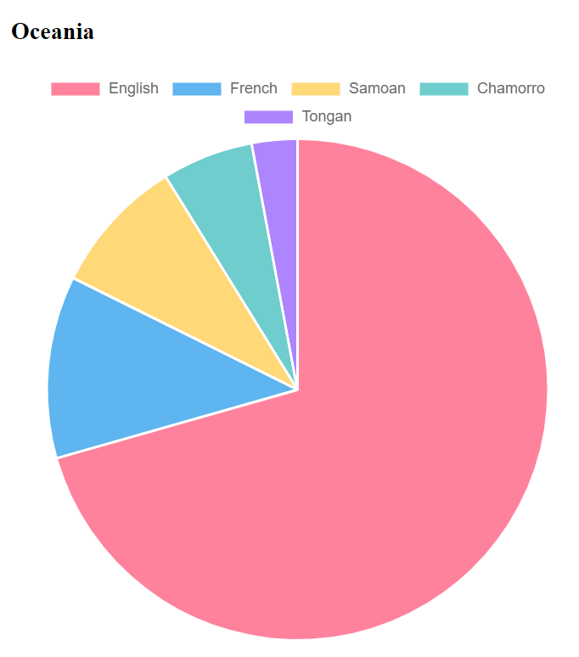
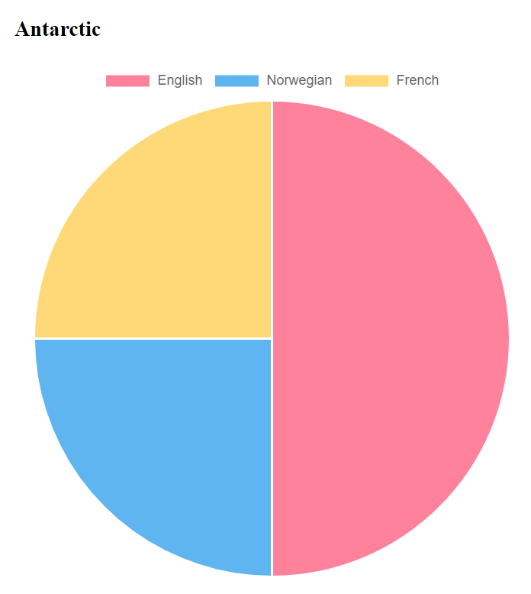

Slide 7
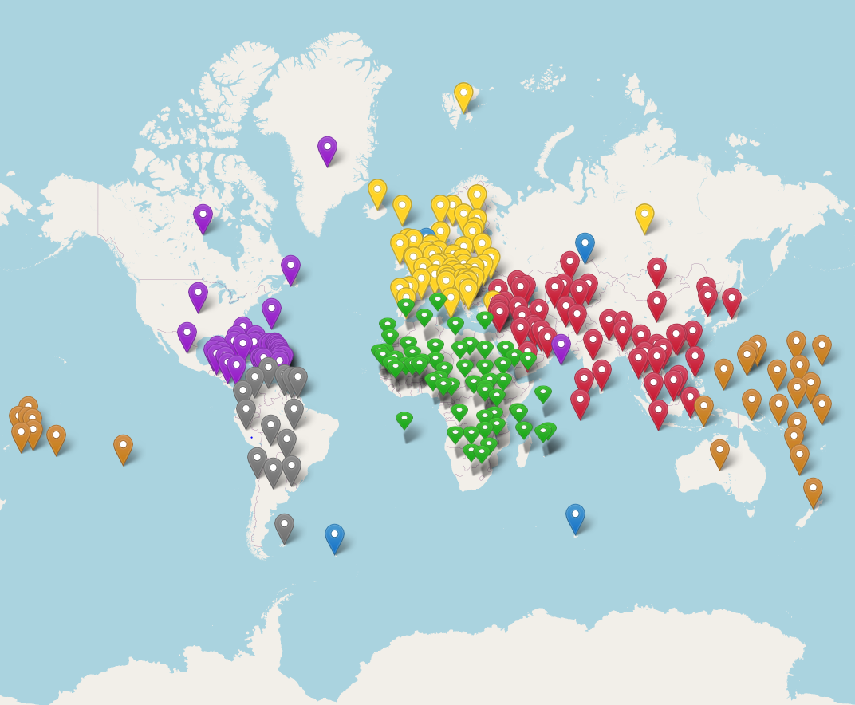
GENERAL INFORMATION MAP
Map of the world with pin markers color-coded by continent
Locations based on coordinates contained in API
More information available upon clicking the markers

Slide 8
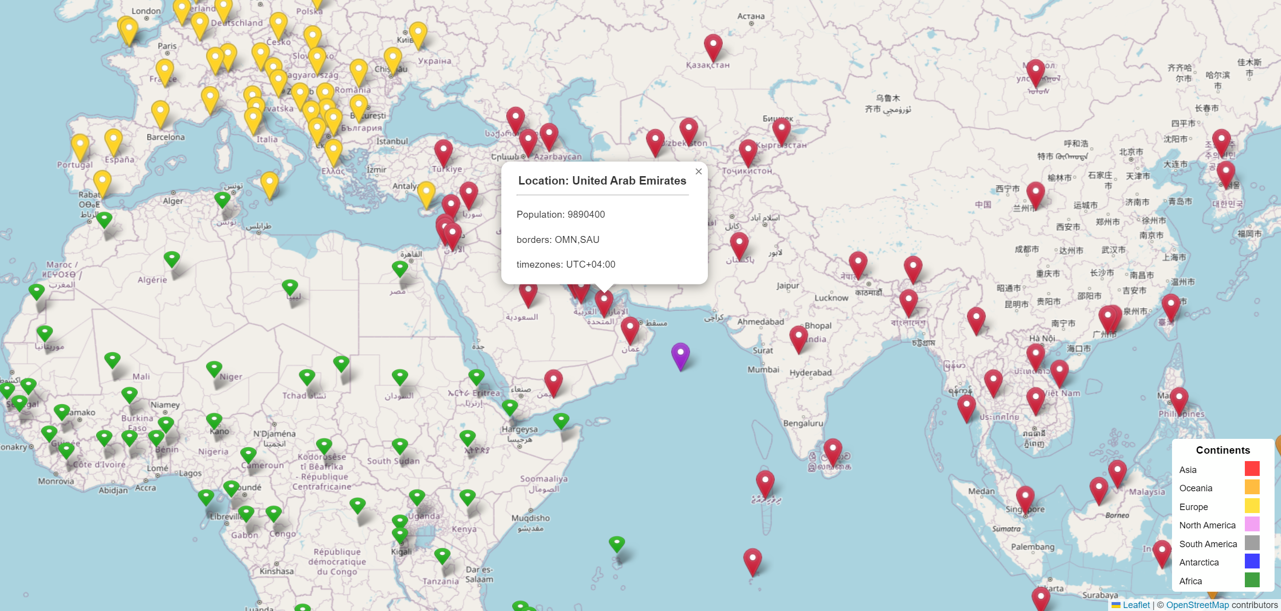

Slide 9
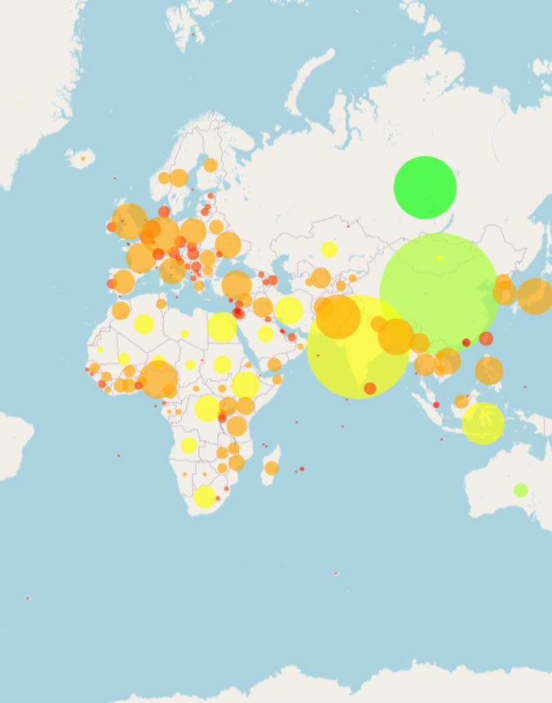
POPULATION BUBBLE MAP
Map of the world displaying circle markers which have radio based on population and colors based on area.
Locations based on coordinates contained in API.
Population density – Highest: China.
Population and area information available upon clicking the markers
Largest/Smallest: Russia/Vatican City
Most/Least People: China/Vatican City

Slide 10
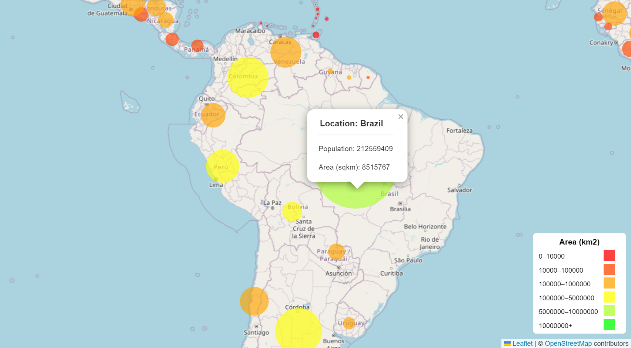

Slide 11

HTML DEMO

Slide 12
QUESTIONS/COMMENTS?

